Slide 1
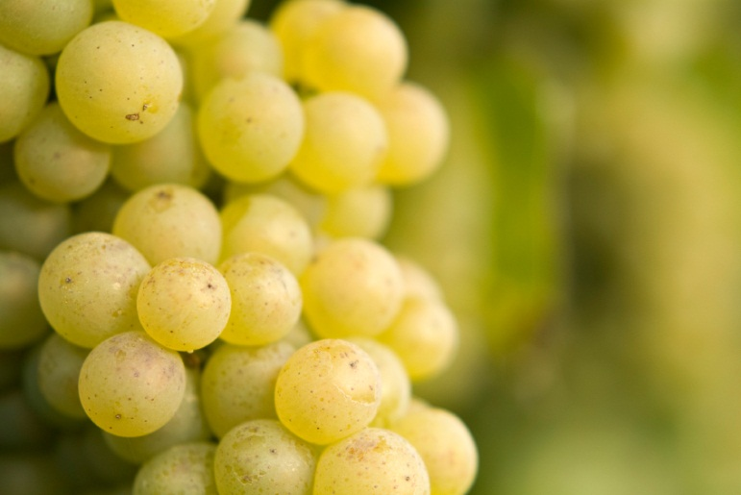
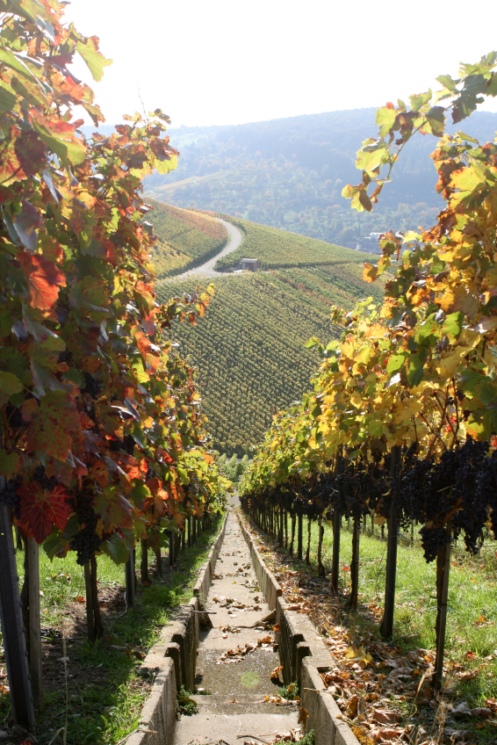
Wine Quality Data
Shalini Harkar
[31.05.18]

Slide 2
Aim of the Exercise:-
To analyze and provide Unicorn Winery insights to maximize the appeal of wines.
Identify relationships between features of the dataset and perceptions of quality
Identify additional analyses to provide insights for wine production and marketing decisions.
Explore ML classifiers on the wine datasets and deciding the best model that could provide accurate classification prediction .

Slide 3
EDA (Exploratory Data Analysis
About Data observations:-
There are 6497 observations and 12 variables.
On Checking if there is all null/ missing value:- There was no missing/ null value in the datset.
All features are continous expect style which is categorical
Description of basic statistic metrics was evaluated like mean, stdev , quartile.
Variables:- 1 sensory-based measure of quality and 11 physiochemical properties
Fixed acidity, volatile acidity, citric acid, pH, alcohol, residual sugar, chlorides, density, sulphates, free sulfur dioxide and total sulfur dioxide.

Slide 4
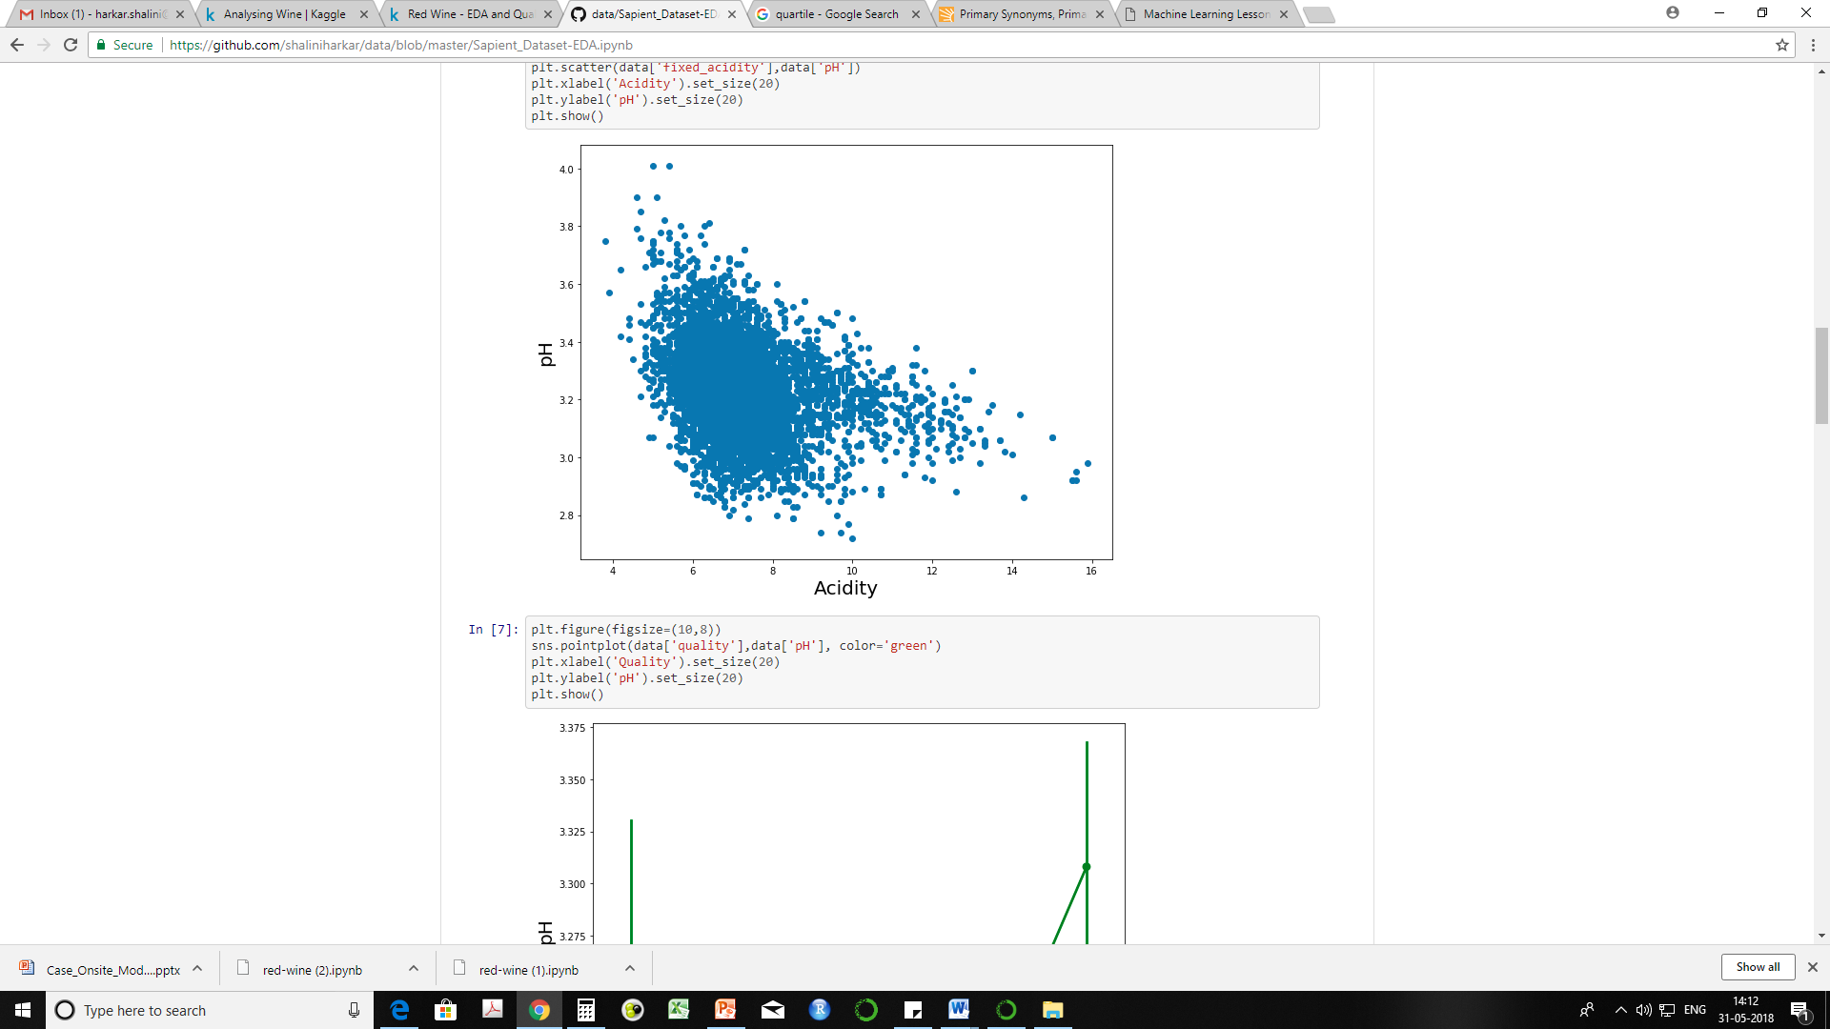
Acidity Vs pH
Acids in wine are an important component .Therefore analysing the relationship of Acidity with other features.
Acidity is measured in terms of ph. Therefore, a correlation of Acidity with Ph was examined using scatterplot. (Lower the pH, the higher the acidity) , better the quality of wine.
From the scatterplot it was inferred that Acidity in wine is important feature.
pH/Acidity vs overall quality rating :
We can infer that higher quality wines have
a comparatively low pH/high Acidity.

Slide 5
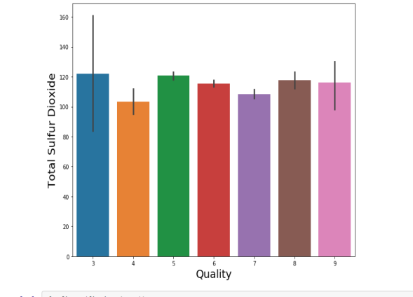
Sulfur Dioxide
Anti-microbial agent and Antioxidant
Higher the Sulfur dioxide content , better the quality of the wine.
Was evaluated by plotting the Quality Vs T. Sulfur content and it was inferred that higher the Sulfur dioxide content , higher is the quality of the wine.
Residual Sugars:-
RS has a balancing relationship with acidity/Ph
High Acidity have high levels of Sugar.

Slide 6
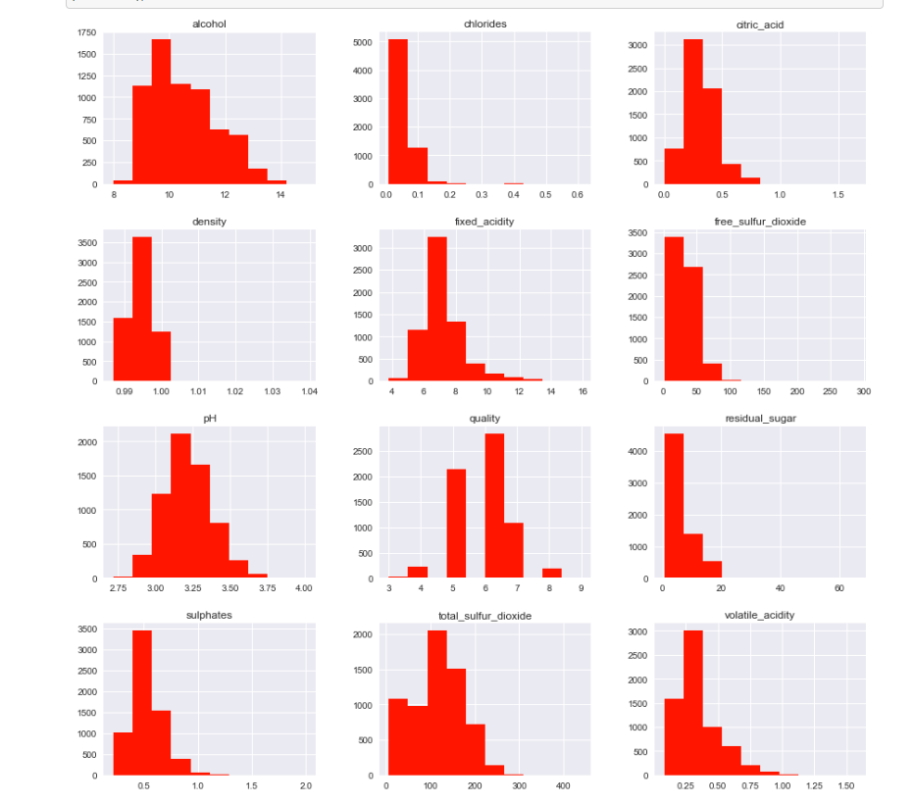
Distribution of features
Scale of the features are quite different. Hence, using algorithms that are based on distance, may focus unfairly on these features.
Data needs to be normalised.
Correlations of features was examined with Correlation Heatmap.
From the plot, following observations were made:-
Most correlated features :- Free sulfur dioxide and total sulfur dioxide (0.72).
Alcohol correlates most with quality than any other features (0.44).

Slide 7
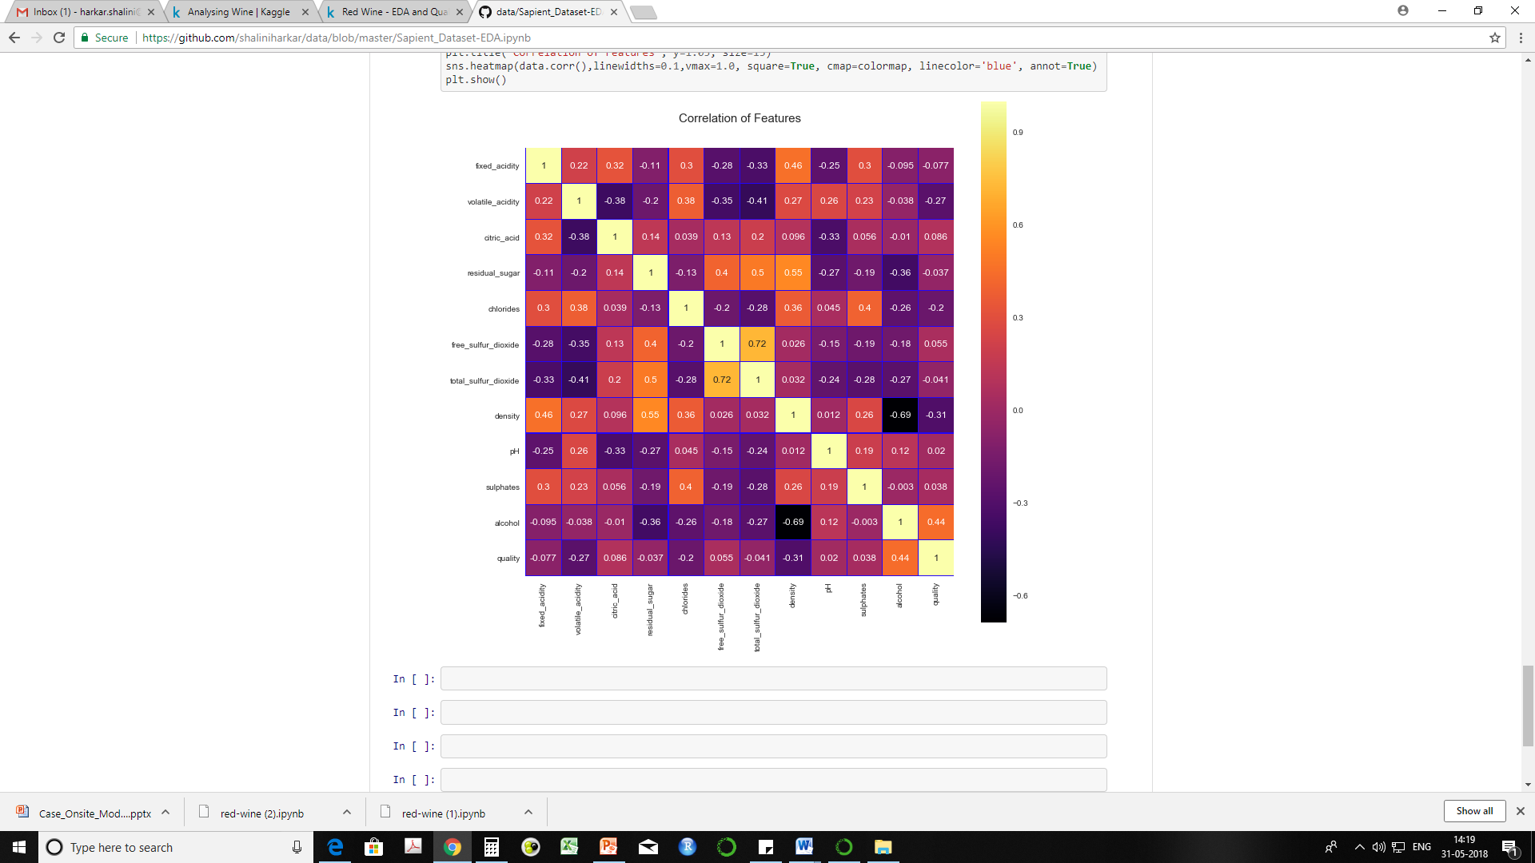
Correlations of features was examined with Correlation Heatmap.
From the plot, following observations were made:-
Most correlated features :- Free sulfur dioxide and total sulfur dioxide (0.72).
Alcohol correlates most with quality than any other features (0.44).

Slide 8
Wine Quality Prediction
On understanding the problem, it is referred to a Binary Classification problem.
As per the “No free lunch theorem” , there is no one model that works best for every problem.
So the ML algorithms which we can use for this problem :-
Binary classifier (Logistic regression)
Decision Tree
Random Forest
These algorithms were applied to predict the quality of wine and the accuracies of the algorithms were compared and the model giving max. accuracy was selected .
As per the observation for the accuracy of the model, Random Forest (ensemble learner algorithms) gave the highest accuracy of about 68%, followed by Decision Trees with 67% accuracy which was followed by Logistic regression with 62%

Slide 9
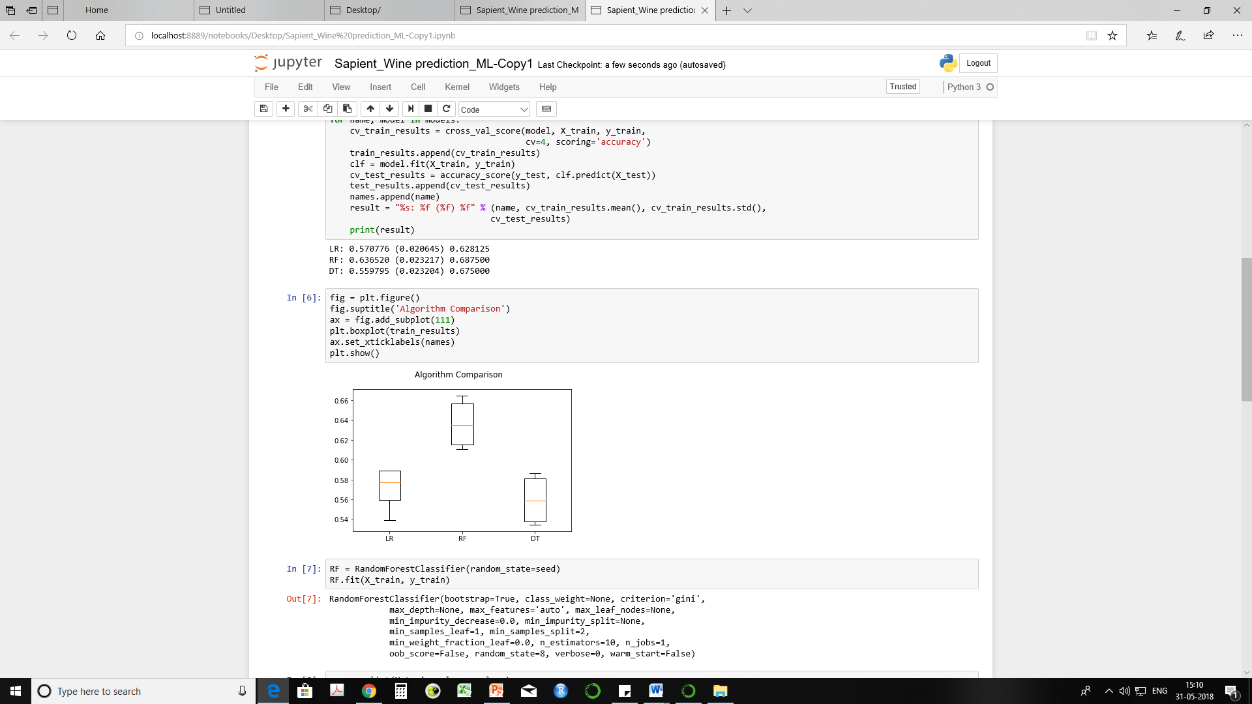
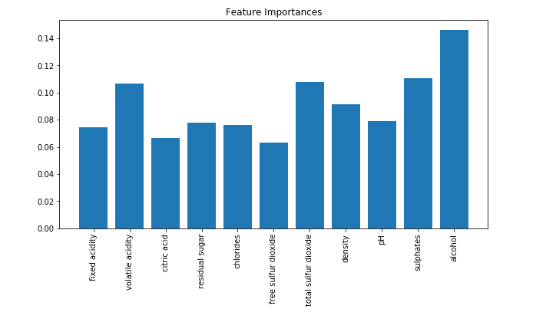
Comparison of the performance of applied algorithms
As per the observation for the accuracy of the model, Random Forest (ensembled learner algorithm) gave the highest training & test accuracy of about 80% & 82%, followed by Decision Trees with training & test accuracy of about 76% & 78% accuracy.
Improving the performance of the model by hyper parameter tuning
Accuracy after hyper parameter tuning :-
Training Accuracy 98%
Test Accuracy ~ 70%

